Slide 1
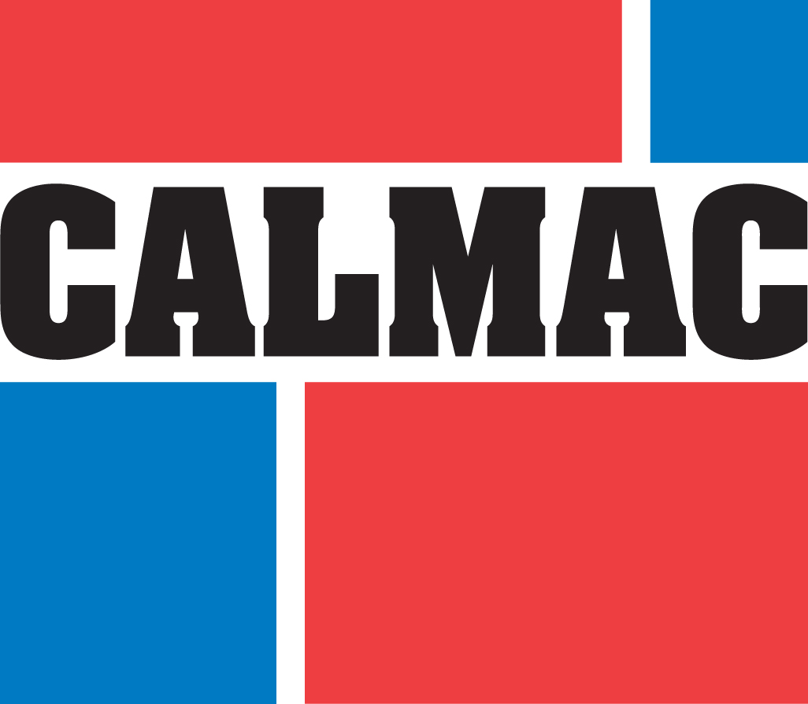
Thermal Storage across the Mid-Atlantic
Challenges & Opportunities
July 2019

Slide 2
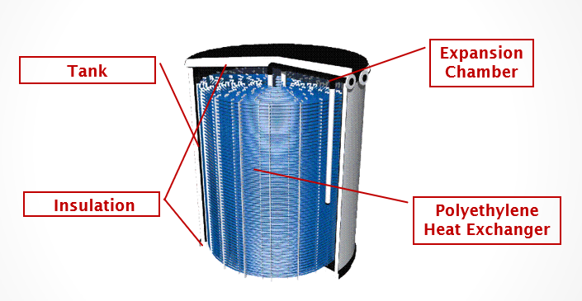
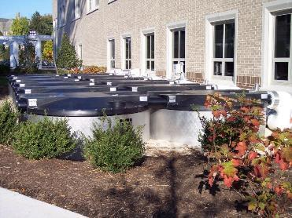
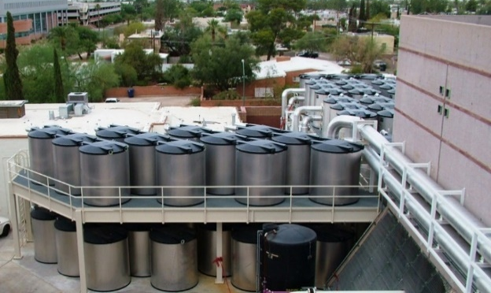
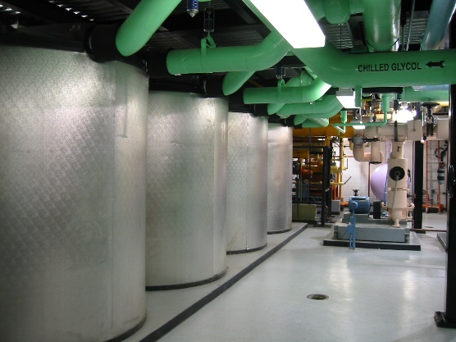
Thermal Storage: a quick background Efficient, cost-effective way to store power
Each tank is a 15-25kW “thermal battery” for 6 to 10 hours
Design life is 40 years; no degradation of storage capacity
Roughly 1/3 of the cost of battery storage
Trane has installed over 500 MW / 3.4 GWh of Calmac thermal storage in the U.S.
.
University, Philadelphia
250 kW / 2 MWh
University, Arizona
4 MW / 27 MWh
New York Class A Office
20 MW / 150 MWh of installations in NYC

Slide 3
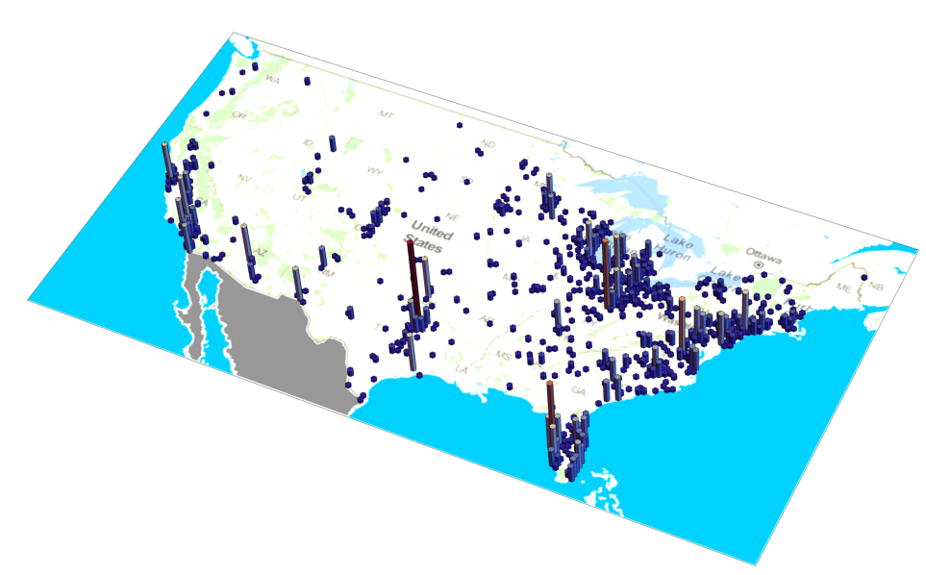
The opportunity Big market with compelling financials – simple energy arbitrage
Thermal storage saves customers money by shifting power from expensive on-peak hours to the nighttime, when energy is much cheaper.
The savings mechanisms are demand charges (utility and grid) and time-of-day rates, which are available to all non-residential customers.
With available state and utility incentives, we are able to see 3-7 year paybacks across the Mid-Atlantic.
Our biggest markets are K12, hospitals, universities, and office, and the opportunity is essentially limitless. Total Addressable Market is 30-50x the current market size.
3D Histogram of active thermal storage projects

Slide 4
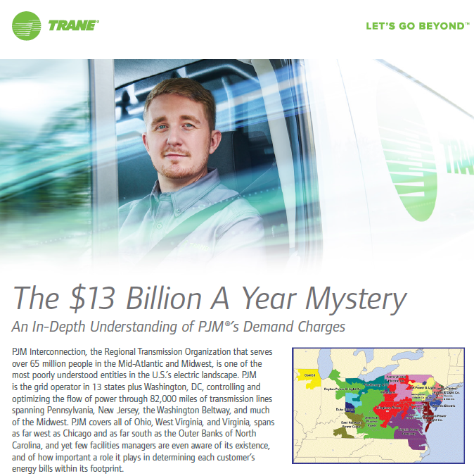
#1 Challenge is Awareness
Almost no one understands demand charges.
Even fewer understand PJM’s Capacity and Network Transmission charges.
Plurality of customers are on fixed priced contracts that cost more, year after year, than default option would
“Everyday customers” like schools, hospitals and universities are unsophisticated in terms of energy – rate and tariff design is opaque, and utility reps are not sufficiently trained to provide them with any clarity.
There is no unbiased resource they can turn to for help.
Trane marketing piece from August 2018

Slide 5
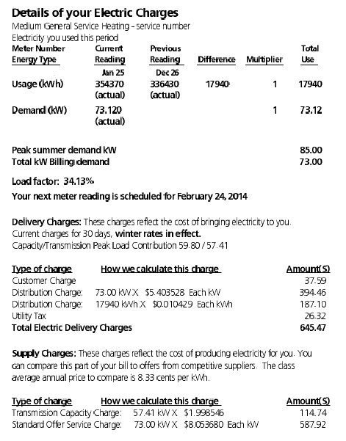
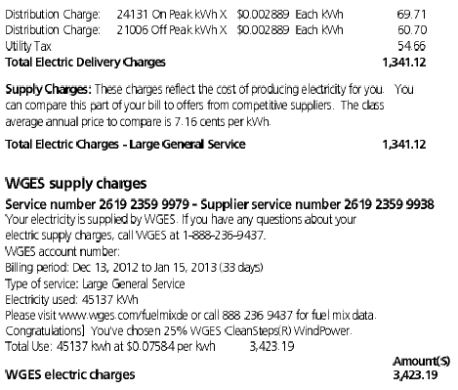
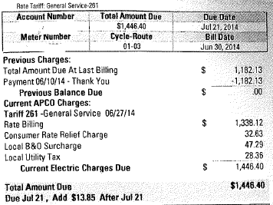
Utility Bills Cloud Understanding
Some states require no itemization at all
“here’s your bill, pay up”
Typical 3rd Party Supply Bill
“blended” electric rate of 7.5 cents/kWh
No mention of PJM’s Capacity or NITS charges, which are peak-related
Default Service Customer
Itemization, but no explanation

Slide 6
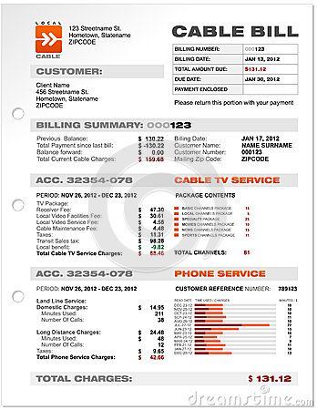
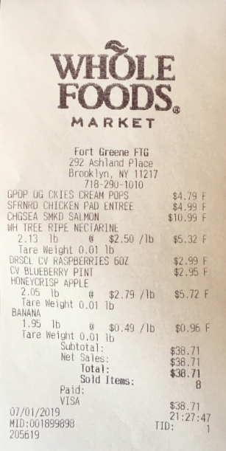
Thought Experiment
Cable bill vs. Grocery Bill
One you receive up front; the other comes in the mail two weeks after the fact
One is itemized in a way that you can easily follow; the other is littered with unexplained fees and surcharges
One is naturally easy for the human mind to grasp; the other is based on abstract telecommunications concepts and is determined by a legal proceeding between the FCC, your public utility commission, and the providers
Which one do you actually understand?

Slide 7
Summary
These are exciting times for all of us in the energy storage industry
Thermal storage business is growing steadily, thanks to new incentives and new appreciation
The technology has been compelling for a long time
The greatest challenge by far is awareness of how C&I customers are charged for their power

